Slide 1

Comparative Analysis of Machine Learning Models for Crop Recommendation Model SUBHADEEP SAHA 2205779 ANKIT RAY 2205535 ANIK PAUL 22051235 SOUMEN SEKHAR BISWAS 2205777
Notes:
AI-generated content may be incorrect. --- This presentation explores the innovative use of machine learning in agriculture, specifically through crop recommendation systems. We will discuss the need for these systems, the fundamentals of machine learning, and how to develop an effective crop recommendation model.

Slide 2
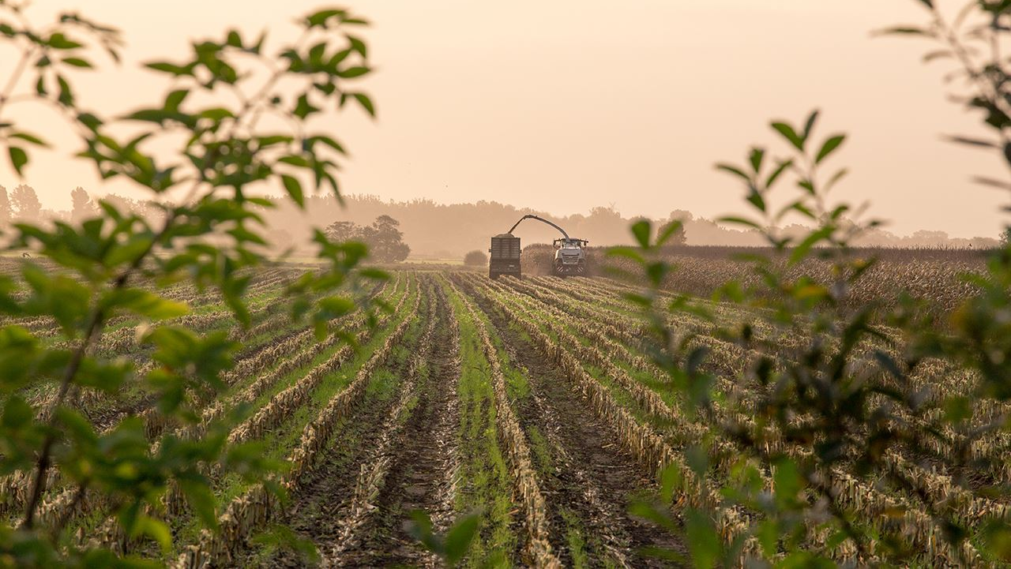
Introduction
Current agriculture is increasingly challenged by population expansion and climate change, rendering optimal crop choice imperative. Machine learning revolutionizes this by scanning soil nutrient levels (N, P, K), climatic trends, and past results to deliver tailored, data-driven suggestions for crops. These AI solutions increase yields by 20-30%, minimize input losses, and improve climate resilience.
Notes:
In this presentation, we will cover the importance of crop recommendation systems and the benefits of using technology in agriculture. Then, we will delve into machine learning fundamentals, develop a crop recommendation model, and explore factors influencing recommendations. Finally, we will look at case studies and practical implementations.

Slide 3
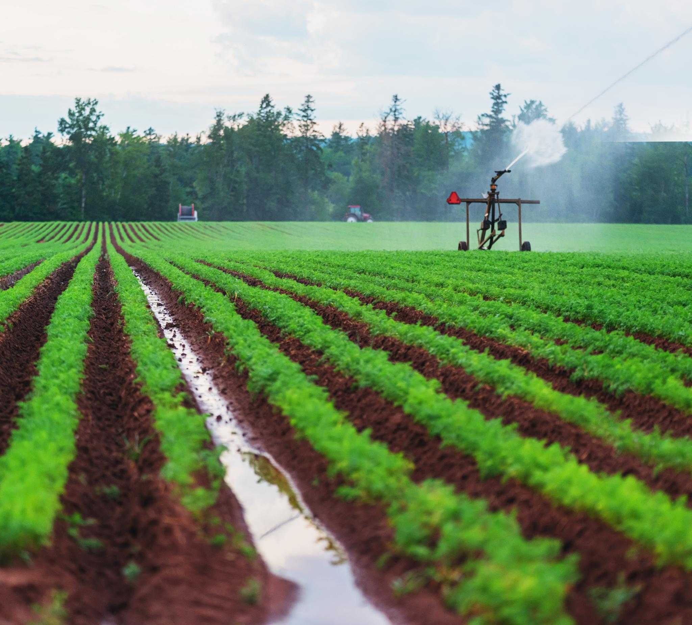
Literature Survey
Conventional crop advisories are based on hand- tested soils and farmer intuition, although worthwhile, may be slow to come by and limited in extent.
Machine learning has come forward as a highly viable tool for agricultural decision-making, providing more scalable and efficient alternatives.
Based on analysis of soil characteristics, climatic trends, and past yield information, ML models can make accurate, localized crop recommendations to maximize agricultural yield and use of resources.
Notes:
Increased population and changing climate conditions necessitate efficient agricultural practices. Crop recommendation systems help farmers choose crops that are best suited for their local conditions, leading to better yields and resource management.

Slide 4
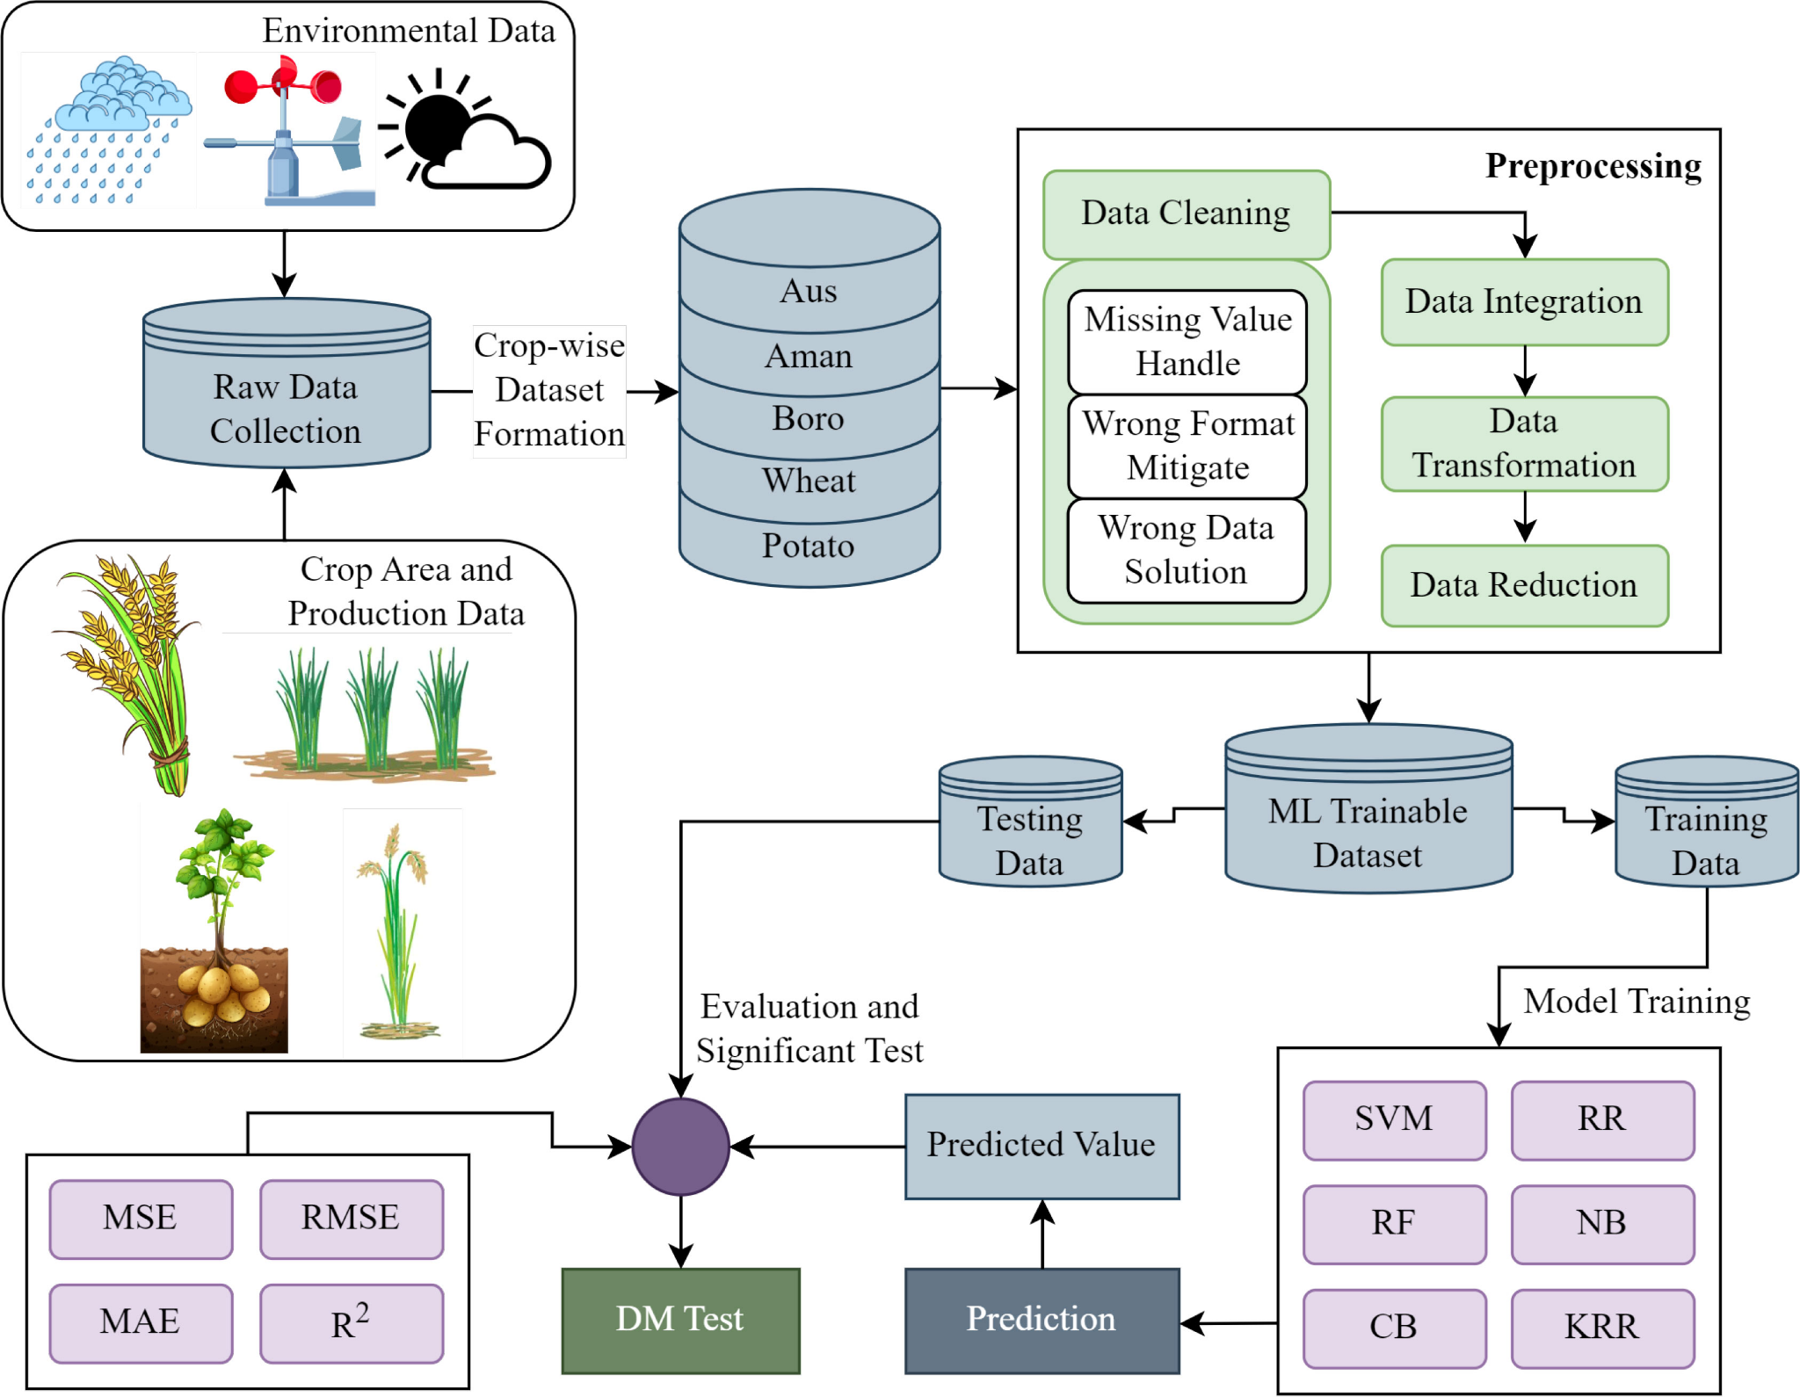
Basic Concepts
GBM sequentially rectifies errors in boosting models. Extra Trees adds randomness to Random Forests.
CatBoost handles categorical features efficiently. XGBoost optimizes gradient boosting with parallel computing and regularization.
Bagging Classifier improves stability by training on different bootstrap samples. SGD Classifier updates incrementally, suitable for high-dimensional data. Ridge Classifier uses L2 regularization for better generalization.
Bernoulli Naive Bayes is for binary data. Passive Aggressive Classifier updates only on misclassification.
Notes:
Technology enhances agricultural practices by providing data-driven insights. Crop recommendation systems reduce risks, save time, and improve crop yield, thus contributing to sustainable agricultural practices.

Slide 5
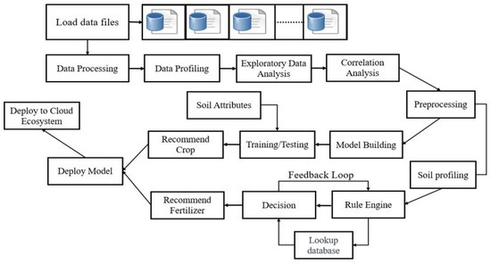
Methodology
Exploratory Data Analysis
Data Preprocessing: Converting the UTC to datetime format makes sense to humans..
Feature Engineering: Generate temporal features using functions from the feature_engine package.
Data Optimization: Iterate through all the columns of a dataframe and modify the datatype to reduce memory usage
Notes:
Machine learning models can analyse vast datasets to identify patterns and trends that help in crop selection. This technology enables precision agriculture, improving decision-making for farmers.

Slide 6
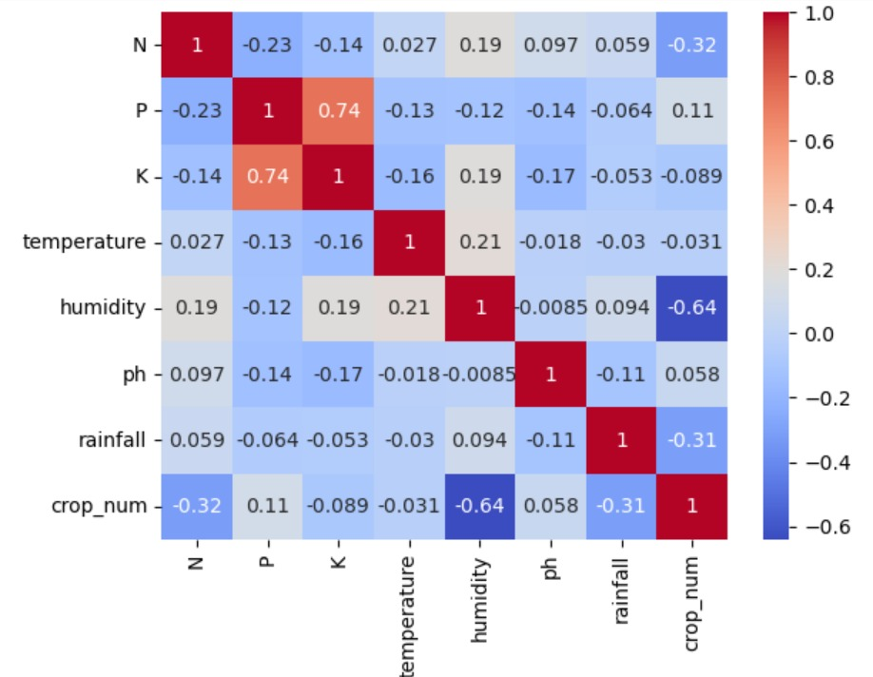
Methodology
D. EDA : The study reveals humidity (-0.64), nitrogen (-0.32) and rainfall (-0.31) to most closely relate to crop choice, highlighting their significance in farm decision making. The factors have a significant influence on crop suitability, highlighting the necessity of tracking soil nutrients and weather patterns for maximum farming productivity and sustainable crop advice.
Notes:
Once the model is built, it must be trained on historical data and tested for accuracy. This process helps in fine-tuning the model to ensure reliable crop recommendations.

Slide 7
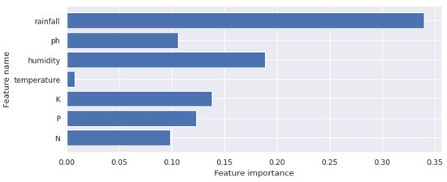
Methodology
E. Feature Importance = refer to image
Notes:
Soil type, nutrients, and pH levels play crucial roles in crop growth. Understanding soil characteristics helps identify the best crops for cultivation in a given area.

Slide 8
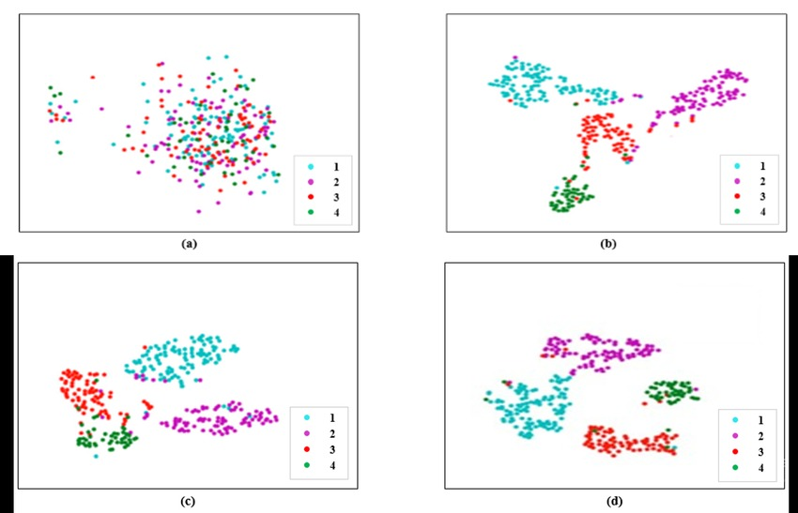
Methodology
Statistical visualization of the testing dataset using t-SNE method (a) Testing dataset (b) Features extracted by the early fusion model (c) Features extracted after adding self-attention (d) Features extracted after adding rice transformer model
Notes:
Several successful implementations of machine learning-based crop recommendation systems have been recorded. These models have shown positive impacts on yield and resource efficiency.

Slide 9
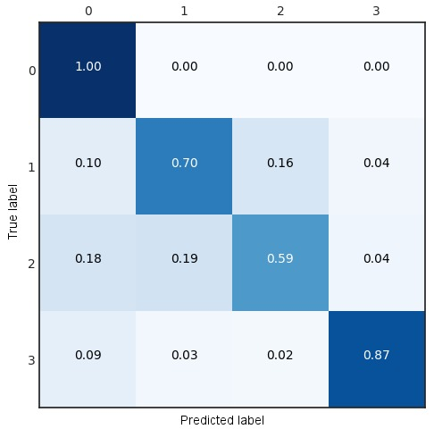
Methodology
G. Defining Function – The confusion matrix is used for understanding how well our classification model performs.
H. Now that the procedures have been completed, we are ready to train and evaluate the machine learning models. For each model accuracy, precision and recall is calculated
Notes:
Despite their benefits, implementing crop recommendation models can present challenges, such as data availability, integration with existing systems, and farmer adoption.

Slide 10

Assessment of Results
The results indicate that ensemble methods like Random Forest Classifier and Naive Bayes achieved the highest accuracy (99.30% - 99.50%) and overall classification performance. Conversely, AdaBoost is exhibited the lowest accuracy (9.54%), highlighting its limitations in handling this dataset.
Notes:
The future of crop recommendation models looks promising, with advancements in machine learning and data analytics. Continuous improvements will enhance their accuracy and usability in agriculture.

Slide 11

Conclusion
The performance indicates the model's robustness in handling complex datasets and its potential for real-world applications in crop recommendation.
Incorporating ensemble techniques or blended models would enhance recommendation accuracy even further. Increasing the system to include real-time weather and soil data, and creating farmer-friendly mobile apps, would greatly amplify the practical significance of this work to agricultural productivity and sustainable farming.
Notes:
In conclusion, crop recommendation models powered by machine learning offer immense potential to optimise agricultural productivity. By understanding the principles, factors, and practical implementations, we can contribute to sustainable farming practices.

Slide 12

Thank You!
We appreciate your attention and participation.
Your engagement is invaluable to our research.
Notes:
Expressing gratitude is vital for maintaining strong relationships both personally and professionally. A simple 'thank you' can brighten someone's day and foster a more positive atmosphere. Recognizing the contributions of others not only boosts morale but also strengthens teamwork and collaboration.

